Slide 1
UNDERWATER IMAGE ENHANCEMENT USING IMAGE PROCESSING
RITIK AGARWAL 19BCE1063
AZAM SIDDIQUI 19BCE1092
ANSH KHATTAR 19BCE1319

Slide 2
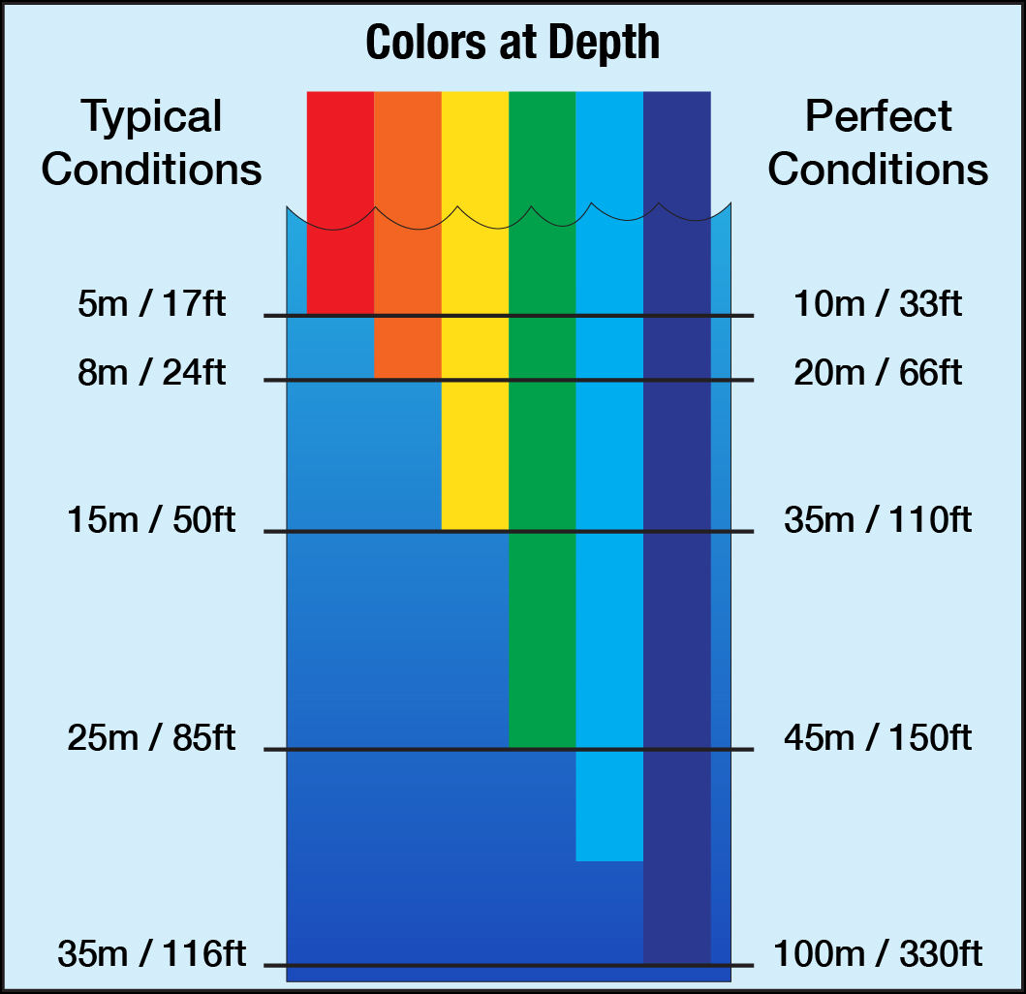
ABSTRACT
The image captured in water is hazy due to the several effects of the underwater medium. These effects are governed by the suspended particles that lead to absorption and scattering of light during image formation process. The underwater medium is not friendly for imaging data and brings low contrast and fade color issues. Therefore, during any image based exploration and inspection activity, it is essential to enhance the imaging data before going for further processing. In our project we plan to incorporate the use of several techniques to achieve this.

Slide 3
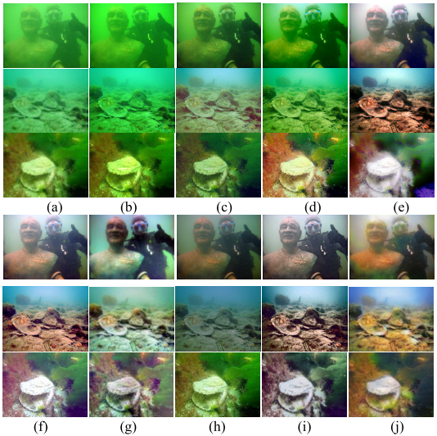
INTRODUCTION
Firstly, we introduce the key causes of quality reduction in underwater images, in terms of the underwater image formation model (IFM). Then, we review underwater restoration methods, considering both the IFM-free and the IFM-based approaches. Next, we present a comparative evaluation of underwater image enhancement methods, considering also the prior-based parameter estimation algorithms of the IFM-based methods, using both subjective and objective analysis. Starting from this study, we pinpoint the key shortcomings of existing methods, drawing recommendations for future research in this area.

Slide 4
IMPLEMENTED METHODS
01
02
03
DCP
Fusion-Matlab
Gamma Correction
It is one of the significant dehazing methods based upon the observation of the key features of the haze-free images.
The principle of image fusion using wavelets is to merge the wavelet decompositions of the two original images using fusion methods applied to approximations coefficients and details coefficients
It controls the overall brightness of an image. Images which are not properly corrected can look either bleached out, or too dark

Slide 5
IMPLEMENTED METHODS
04
05
Integrated Colour Model (ICM)
Histogram Equalisation & Transformation
This technique is used to improve contrast in images. It accomplishes this by effectively spreading out the most frequent intensity values, i.e. stretching out the intensity range of the image.
Firstly, the contrast stretching of RGB algorithm is applied to equalize the color contrast in images. Secondly, the saturation and intensity stretching of HSI is used to increase the true colour and solve the problem of lighting

Slide 6
Tools and Libraries to be Used:
OPENCV:OpenCV is a huge open-source library for computer vision, machine learning, and image processing.
MATLAB: Image Processing Toolbox™ in MATLAB provides a comprehensive set of reference-standard algorithms and workflow apps for image processing, analysis, visualization, and algorithm development.
Numpy: By reading the image as a NumPy array ndarray , various image processing can be performed using NumPy functions. By the operation of ndarray, you can get and set (change) pixel values, trim images, concatenate images, etc.

Slide 7
RESOURCES
Y. Tao, L. Dong and W. Xu, "A Novel Two-Step Strategy Based on White-Balancing and Fusion for Underwater Image Enhancement," in IEEE Access, vol. 8, pp. 217651-217670, 2020, doi: 10.1109/ACCESS.2020.3040505.
H. Chang, "Single Underwater Image Restoration Based on Adaptive Transmission Fusion," in IEEE Access, vol. 8, pp. 38650-38662, 2020, doi: 10.1109/ACCESS.2020.2971019.
Y. Wang, W. Song, G. Fortino, L. Qi, W. Zhang and A. Liotta, "An Experimental-Based Review of Image Enhancement and Image Restoration Methods for Underwater Imaging," in IEEE Access, vol. 7, pp. 140233-140251, 2019, doi: 10.1109/ACCESS.2019.2932130.
C. O. Ancuti, C. Ancuti, C. De Vleeschouwer and P. Bekaert, "Color Balance and Fusion for Underwater Image Enhancement," in IEEE Transactions on Image Processing, vol. 27, no. 1, pp. 379-393, Jan. 2018, doi: 10.1109/TIP.2017.2759252.

